Slide 1

Overdose Deaths
Heroin vs Pharmaceutical Opioids
Alicia Fazzone
CS 555

Slide 2
Project Outline
Explanation of Dataset
Visualization of Data
Hypothesis test: Heroin < Pharmacutical Opiods
Correlation Analysis

Slide 3
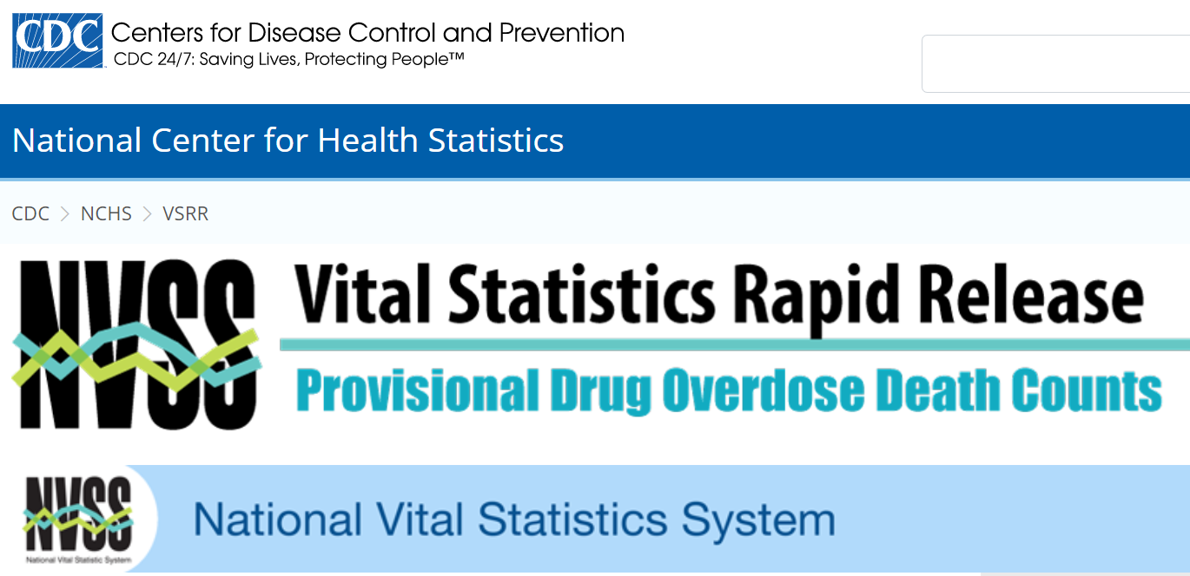
Data Set: cdc.gov/nchs/nvss/vsrr/drug-overdose-data.htm
Products - Vital Statistics Rapid Release - Provisional Drug Overdose Data (cdc.gov)

Slide 4
Data Preprocessing Original Data set: 12 columns 53,191 rows Final Data set: 6 columns 315 rows
Keep Columns:
State
Year 2016 – 2021
Indicator
Create Columns:
Total Deaths (Aggregate per year)
Transpose Indicator Rows to Column aggregate per state:
Heroin
Other Opioids
Cocaine

Slide 5
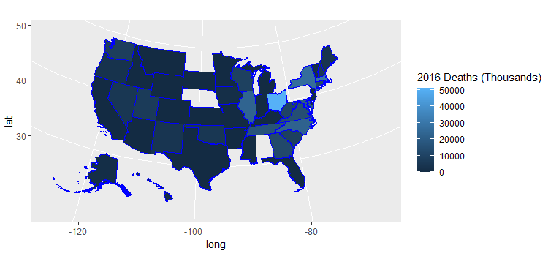
2016 Visualization: urbnmapr Package

Slide 6
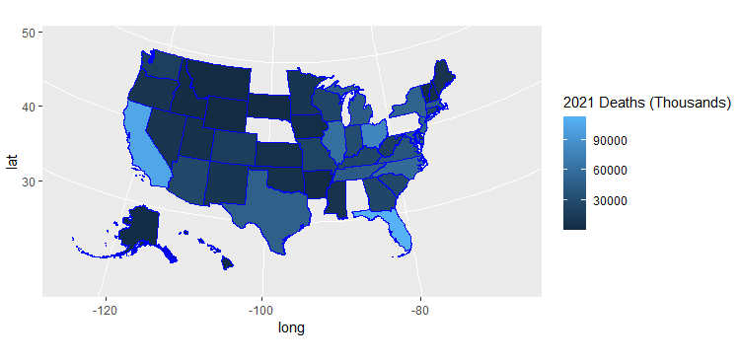
2021 Visualization: urbnmapr Package

Slide 7
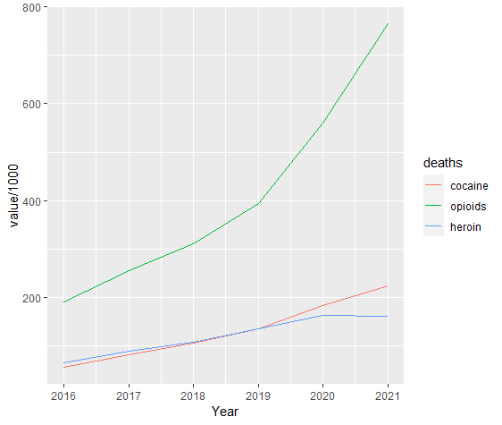
Total US Deaths Per Year

Slide 8
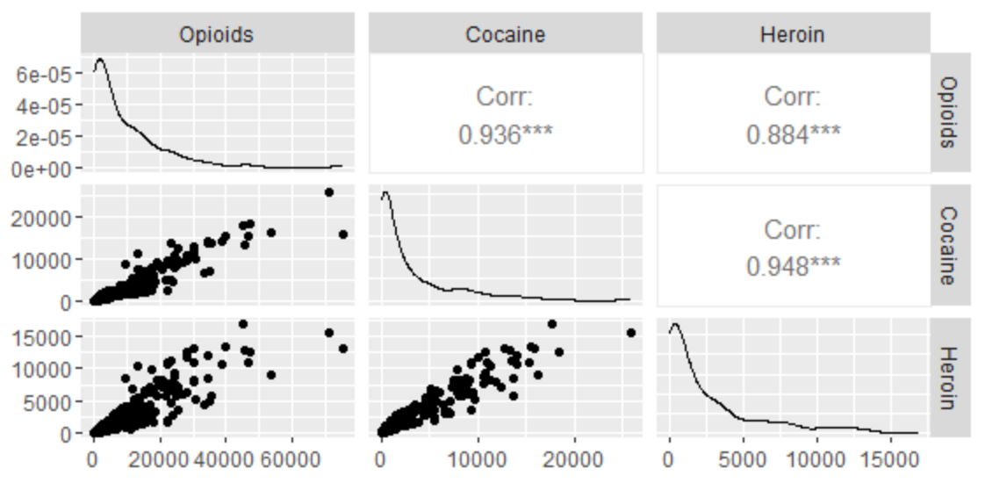
Correlation Analysis

Slide 9

Hypothesis Conclusion
H0: Opioids <= Heroin
H1: Opioids > Heroin
α=0.05
Tested Using:
Linear Regression
Anova
2 Sample Means
Reject the null Hypothesis

